Slide 1
Increasing SAT and ACT participation rates across the US

Slide 2
Agenda:
Background
Objective
Study on participation rates for:
SAT
ACT
Conclusion

Slide 3
Background
SAT and ACT are both standardized tests covering the same basic subjects
Optional for college admissions, but can increase chances of being awarded merit scholarships
Created and administered by different test providers.
In 2016, SAT released a new format which brings SAT and ACT even closer.

Slide 4
Objective

Slide 5
OBJECTIVE of Study:
Increase both SAT and ACT participation rates across the United States
METHOD:
Explore trends in participation rates
Identify correlated factors
OUTCOMES:
Identify opportunities for investment
Propose focus areas based on correlated factors

Slide 6
SAT
Increasing participation rates for:

Slide 7
Overview
SAT participation rates have been growing
The number of states having full SAT participation increases through the years
Underlying factors for the growth:
Redesigned SAT format
Reduced costs for studying SAT

Slide 8
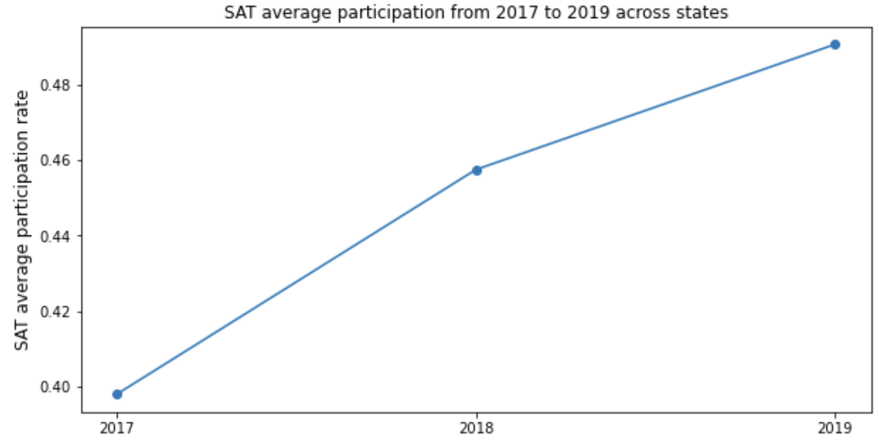
SAT participation rate growth
* Average participation is increasing as the year passes
* Growth rate from 2018 to 2019 slowed down compared to the growth rate from 2017 to 2018.

Slide 9
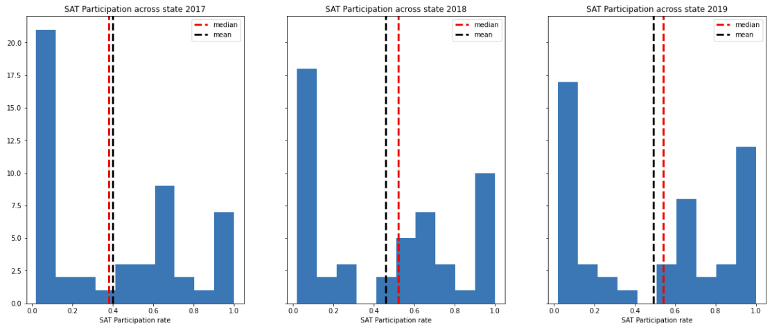
The number of states having higher SAT participation rates
There is an obvious increase in the number of states having (80%-100%) SAT participation rate
Likewise, an obvious drop in the number of states having 0% to 10% SAT participation rate

Slide 10
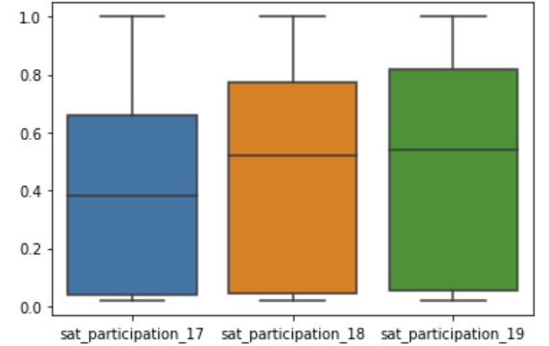
Increase in 75th percentile for SAT participation rates
The 75th percentile SAT participation rate rises significantly from 0.66 in 2017 to 0.82 in 2019

Slide 11
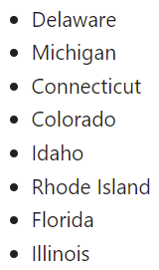
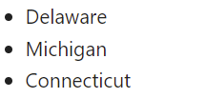
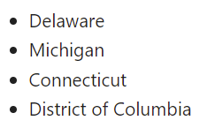

The number of states having full SAT participation (100%)
2017
(4 states)
2018
(5 states)
2019
(8 states)
States with 100% SAT participation increases over the years.
Colorado switched from having 100% ACT participation rate to 100% SAT participation rate

Slide 12


The underlying factors for the growth in SAT participation
Redesigned SAT format
SAT more aligned with Common Core standards in English and Math
Reduced costs for studying SAT
X
FEES
FREE
+
Free personalized test prep
Fee waivers
Free 2 SAT tests

Slide 13



Recommendations
Three areas to target
Target poorer states with “No fees and All free” slogan
Target states with neither 100% participation rates
Market the redesigned format and replicate Colorado strategy

Slide 14
ACT
Increasing participation rates for:

Slide 15
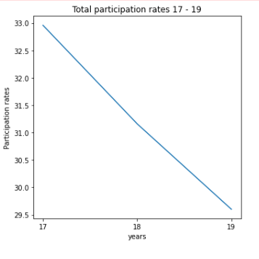
Participation rates
Overall decrease in participation
Declining use of ACT
Fig: Total participation in US 2017 to 2019

Slide 16
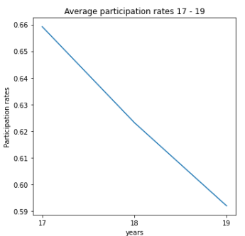
Participation rates
Decrease in average state participation
Declining use of ACT
Fig: State average participation in US 2017 to 2019

Slide 17
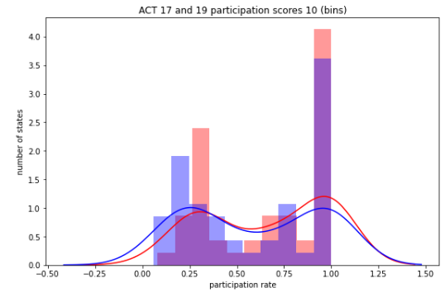
Participation rates
Increasing left skew
Decrease in state participation
Declining use of ACT
Fig: State average participation in US 2017 and 2019

Slide 18
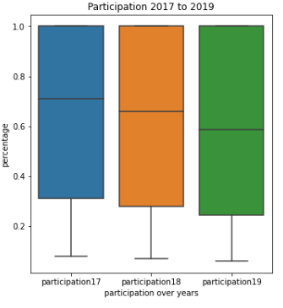
Participation rates
Decreasing 50th percentile
Decreasing 25th percentile
Fig: State participation in US 2017 to 2019
Notes:
We can expect participation rates similar to former years.

Slide 19
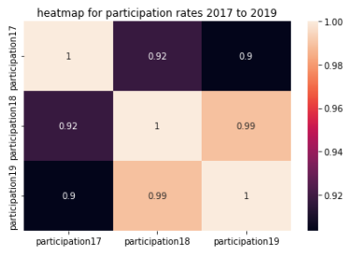
Participation rates
Positive correlation of participation value yearly
Participation value from past years relate to later years
Fig: Correlation between participation 2017 to 2019
1 means closely related, -1 means not related
Notes:
We can expect participation rates similar to former years.

Slide 20
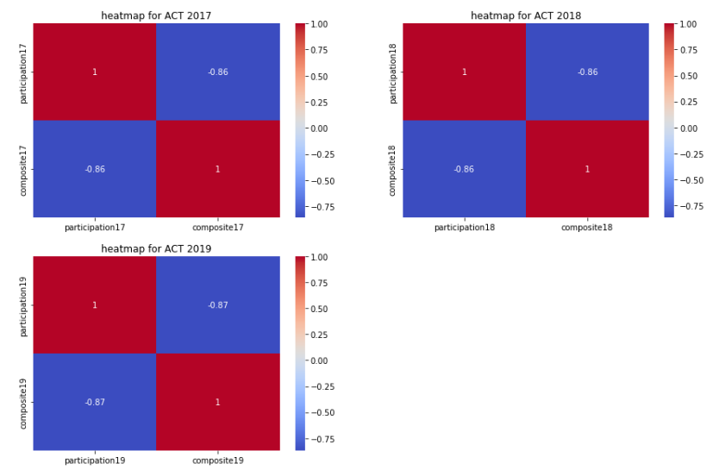
Participation-score relationship
Negative correlation
Scores not related to participation
Scores is not the reason for poor participation
Fig: Correlation between participation and scores 2017 to 2019

Slide 21
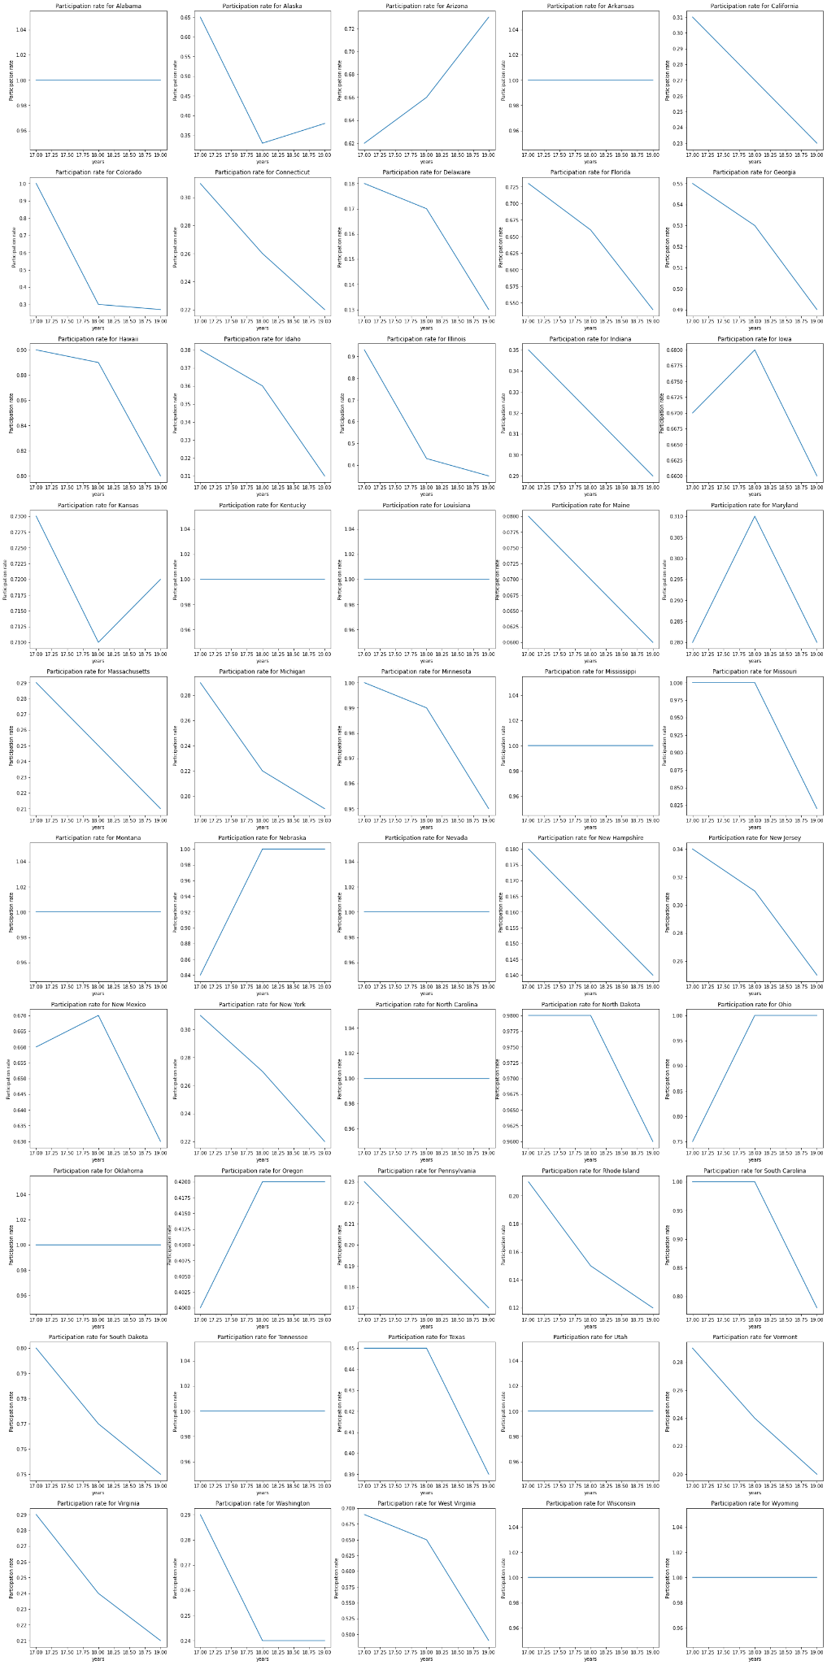
State Participation
Decreased participation :32
Increased participation : 4
No change: 14
Drastic change
Colorado, 1 to 0.27
Illinois, 0.93 to 0.35
made standardized test optional
Fig: Participation rate for individual states

Slide 22
ACT recommendations
Focus resources on states with high participation
States (>70% participation rate),2019:
Hawaii (0.8)
Kansas (0.72)
Minnesota (0.95)
Missouri (0.82)
South Dakota (0.75)
South Carolina (0.78)
North Dakota (0.96)

Slide 23
ACT suggestions
Associate desired jobs with ACT
Associate top university courses with ACT
Create a ‘ACT’ identity
Create a cult of followers
Work with credit companies; credit packages
Work with legislators and politicians
Work with religious/community leaders
Work with universities

Slide 24
Conclusion

Slide 25
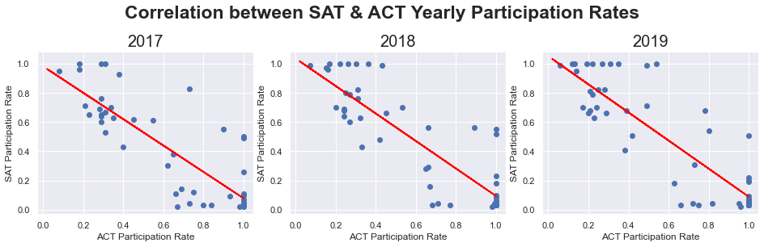
SAT and ACT participation rates are inversely correlated
Participation rates can be driven by state legislation: Some states make it mandatory to take either one of two tests.

Slide 26
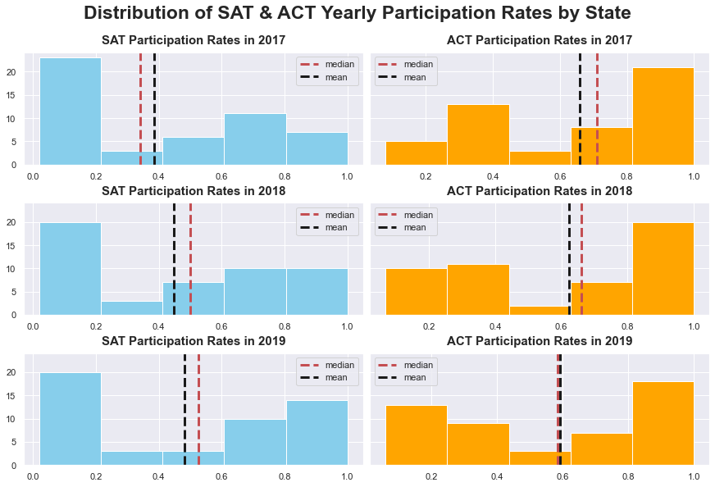
Distribution of SAT and ACT participation rates mirror each other
SAT participation rates have been lower than ACT, but there has been an uptrend for SAT rates
Conversely, frequency of states with high ACT participation rates are higher. However, participation rates have been trending downwards

Slide 27
Recommendations
Both test providers can collaborate to divide and conquer focus areas and reduce competition from each other
Opportunities:
Florida: rich state with average participation rate. Ok to market both tests aggressively
Alaska also has below average participation rates for both ACT and SAT. More feasibility studies recommended before investing.
Combine resources to combine both tests into one standardized test

